Slide 1

HB 410 District Task List
ProgressBook Suite Webinar
StudentInformation
October 2017
StudentInformation State Support Team

Slide 2

vHB410 District Task List

Slide 3
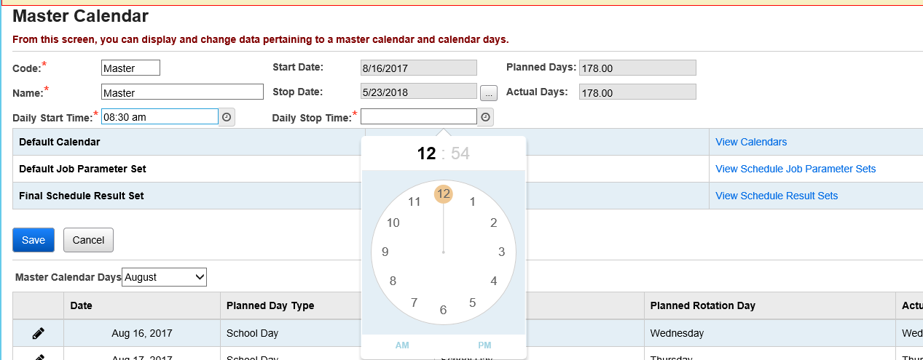
HB410 District Task List
Start & End times on Master Calendar and sub-calendar maintenance
  Enter dates manually as HH:MM am or pm
Notes:
The Master Calendar Maintenance page and Sub-Calendar pages now have fields for Start and End Times.
If the start and/or stop times are the same as the master calendar, you can leave them blank on the sub-calendar
A date picker tool is available for you to choose the time or it can be entered manually by typing in the date as HH:MM am or pm

Slide 4
HB410 District Task List
Absence Qualifiers – Late/Tardy Qualifier
Recommend two Tardy types
  Excused
  Unexcused
Tardy will count towards HB410 & EMIS Attendance
Time In | Tardy | Absence Threshold
No | Late/Tardy | Not Counted Against
Yes | Late/Tardy | Counted Against
Notes:
We recommend that Late/Tardy have two separate codes. Now that they will be considered for HB410 and EMIS attendance, you need the ability to indicate whether it’s excused or unexcused.
Tardy will count towards HB41- & EMIS ONLY if a time in exists. If no Time in, the tardy will not be considered because we have no way of calculating the time from when the student should have been there to when he actually arrived. With no time, this could be for a policy by the district that if you’re less than 15 minutes late, we don’t’ count it against you but do record the fact that you were tardy that day. This would be considered the ‘rounding’ factor. In this scenario, the district chooses to ‘round down’.

Slide 5
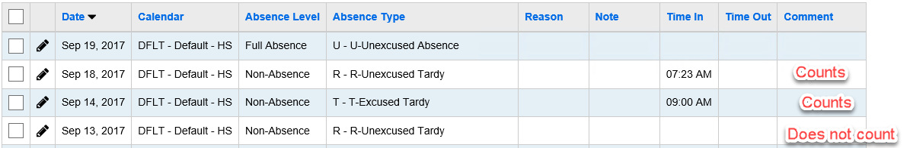
HB410 District Task List
Late/Tardy
Notes:
The two Tardies with Times In will count since we can tell when they actually came into the building. The ‘R’ Sept 13th Tardy will not be used.

Slide 6
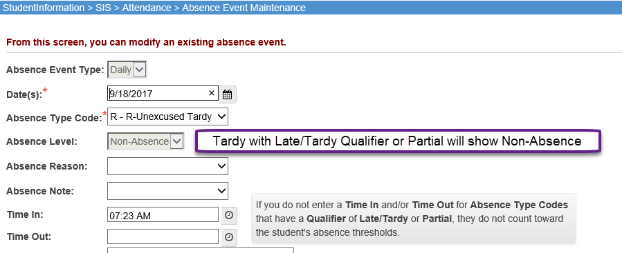
HB410 District Task List
Absences with Late/Tardy or Partial Qualifier on Absence Type
Notes:
When editing the absence event, the Absence Level will always show ‘Non-Absence’ . This is currently as designed. These tardies will still count towards HB410 and EMIS regardless of the absence level here.

Slide 7
HB410 District Task List
New ‘Partial’ Qualifier
  Must be used to enter partial absences that span AM to PM portion of the day
  Multiple absences with the ‘partial’ may be entered per day
  Partial Events are calculated as Excused or Unexcused
    Need Excused Partial and Unexcused Partial Absence Type
  Time In and/or Time Out fields must be entered to record a partial day
    If no Time In and Time out on Absence event, record will be ignored
Notes:
New Partial qualifier must be used to enter absences that span from the AM to PM sections of the day especially if the absence spans over lunch.

Slide 8
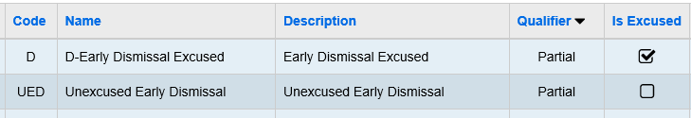
HB410 District Task List
Partial Absence Types
  Should be ‘Report to EMIS’
  Recommended to have two codes
    Excused Code
    Unexcused Code
Notes:
Any absence type that represents time out during the school day should be report to EMIS unless the building is rounding down and the Tardy doesn’t meet their minimum time with rounding.
Since partial Absences (late arrivals or early dismissals) now count as absence time, there needs to be a designation between excused and unexcused. Partial Absence types are needed especially when an absence for part of a day spans time over lunch.

Slide 9
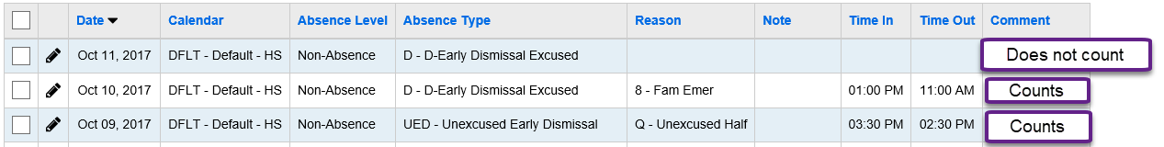
HB410 District Task List
Partial Absences without times will not be included in the calculations for HB410 or EMIS Attendance
Notes:
In this example, the first ‘early dismissal won’t count because we have no way of telling the time the student was out
In the next two records, they both count because of times in and out.
If student leaves early, enter the end of the day as the time in. Time out would be the time they left.

Slide 10
HB410 District Task List
Out of School Suspensions
  Count towards EMIS reporting as Unexcused Absences
  Count towards Excessive Absences threshold for HB410
  Do not count towards Habitual Truancy threshold
Notes:
Clarification on Out of School Suspensions
It was previously stated that Out of School suspensions do not count towards HB410, however, they do. Though suspensions are considered unexcused absences, they should not count towards truancy triggers because suspensions represent a legitimate excuse to be out of school. Suspensions do count toward excessive absences because the definition of excessive absences does not distinguish between legitimate and not legitimate reasons for missing school.

Slide 11
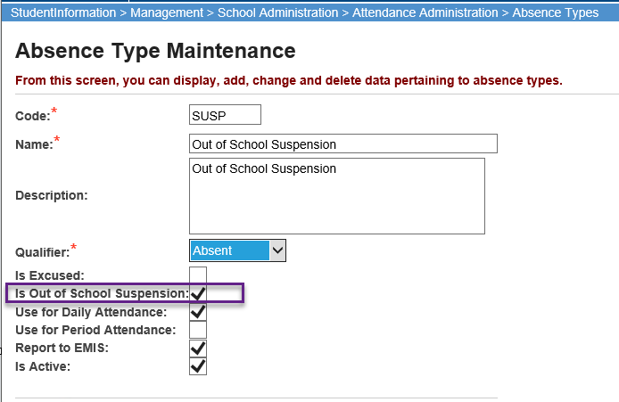
HB410 District Task List
New option added to identify absence type as Out of School Suspension
Notes:
The ‘Is Out of School Suspension’ indicator will tell the attendance reports how to consider the absence for suspensions. Out of School suspensions should ALWAYS be Unexcused absence.

Slide 12
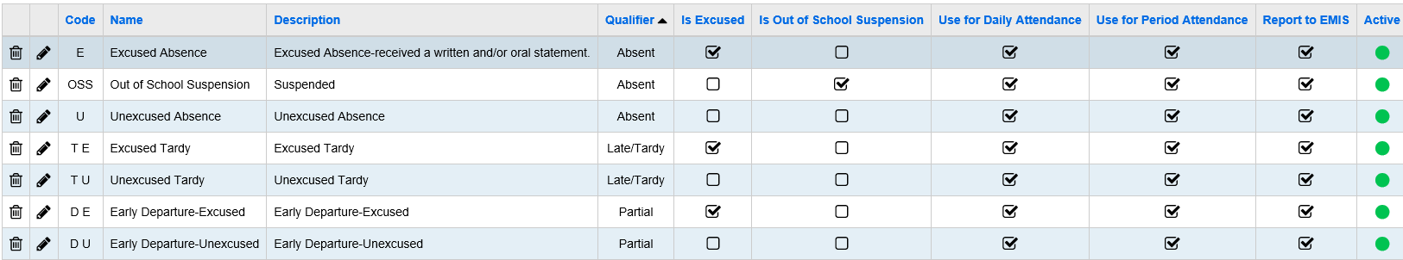
HB410 District Task List
Minimum recommended Absence Types needed
Notes:
For any absence type you use, you need the ability to designate the time as Excused or Unexcused. The codes in this slide are only a recommendation on the minimum codes you need to effectively track HB410 and EMIS Attendance. In this screenshot they are all marked to use on Daily Absences and Period Absence. It’s only necessary to mark one column depending on the type of attendance you track, however, it doesn’t hurt anything if you’re a daily attendance school and have ‘use for period attendance’ marked. If you are a period Attendance school, you will need the additional codes for Daily attendance to be available to record partial absences on Daily attendance that aren’t captured in period attendance. SI is currently only looking at Daily Attendance to determine EMIS and HB 410 Compliance.

Slide 13
HB410 District Task List
Updating Absence Qualifiers on existing Absence Types
If you want to change the qualifier on an absence type from Absent to Partial or Partial to Tardy, etc.
  Submit a helpdesk ticket to SSST with your request
  When changing qualifiers, some mass updating will need to occur to make the change to existing absence event records
Notes:
This type of change may be updating internal values relevant to the absence type qualifier. If a code needs updated, submit the request in a Cherwell Ticket to SSST. We will make the necessary mass updates.

Slide 14

HB410 District Task List
New Informational message added to Add/Edit version of School Absences

Slide 15
HB410 District Task List
Attendance Reports
  will be updated in the near future to include calculations for HB410 Attendance
Attupemis – Will be updated soon
HB410 Ad Hoc Reports – Currently in testing
Report Card Attendance
  Will be discussed at the October SIAC Meeting
Notes:
Reports are in the process of being updated. First will be those most commonly used per SIAC

Slide 16
HB410 District Task List
Questions & Answers

Slide 17


HB410 Attendance
What is the difference between ‘Habitual Truant’ and ‘Excessive Absences’
Habitual Truant thresholds only include ‘unexcused absences’.
Excessive absences include both excused and unexcused.
There are different thresholds for both

Slide 18
HB410 Attendance
If a student is 18 or over, must we track their attendance?
HB410 requirements only apply to students of compulsory education age. However, a district cannot withdraw an 18-year-old student for being truant unless the student makes the request.
Notes:
Districts are not obligated to conduct attendance intervention meetings for students who are 18 years old, however, it is in their best interest to do so to keep them from becoming a dropout.

Slide 19
HB410 Attendance
How do we count recess? Per Office of accountability, recess isn’t included in instruction time.
Recess is not tracked in SI. If an absence covers recess time, the school would need to adjust time in/out to accommodate recess if they wanted it excluded from the time out for an absence

Slide 20
HB410 Attendance
How is rounding taken into consideration in the calculation?
Absences will be calculated to the minute. If a school has a policy to round down if a student was absent less than 15 minutes, they would add the Tardy but not enter a time in if it fell below 15 minutes.
Notes:
In this example, the building is choosing to round down. All absences with times in and out will be calculated to the minute. At a minimum, districts must track and report student attendance to the nearest hour, however, districts may track and report in greater detail.
If a district’s policy is to round to the nearest hour, the district would round down to the nearest hour for a student who comes in 15 minutes late and enter the student’s time accordingly on the absence event record. On the other hand, if a district tracks and reports attendance in greater detail, it may enter the exact time in which the student arrived or left school, which is how we are recommending attendance be taken.

Slide 21
HB410 Attendance
Do the codes with the partial qualifier impact report cards?
Currently, they do not. There have been requests to leave report card attendance as-is. This will be discussed at the next SIAC.

Slide 22
HB410 Attendance
A building has students who have late arrival or early dismissal every day, how should we handle these kids?
It is recommended that their calendar reflect the exceptions, however, this could multiple exponentially, the number of calendars to accommodate. If student has FTE < 100, FTE will be used in attendance calculations
Notes:
If a student’s regular school day is reduced because of late arrival or early release, the district should track and report attendance/truancy for the time the student is scheduled to be in the building. FTE will be used to do this.
If a student attends half of this time at his home district and half time at a JVS, the home district and JVS should communicate and share data regularly to ensure the student is not habitually truant or excessively absent.
If a student participates in CCP on a college campus, the district would not need to coordinate with the higher education institution to share data. The student’s status would only be based on the time the student is required to attend the home school in the district.

Slide 23
HB410 Attendance
How should community schools track attendance?
Community schools are required to follow the same requirements for HB410 and EMIS attendance as Traditional districts. Students participating in a virtual environment are expected to participate in instructional activities on a consistent basis that conforms to the school calendar.

Slide 24
HB410 Attendance
Do public preschools need to track and report attendance by the hour?
Though public preschools are not subject to HB410 provisions, the Department encourages preschools to track and report attendance by the hour

Slide 25
HB410 Attendance
Should buildings switch to taking period attendance?
Not at this time. Initially, we are addressing daily attendance and then will be addressing period attendance. With ODE indicating there will be changes in how attendance is reported next year, we are waiting to find out what those changes will be before making any further recommendations.

Slide 26
HB410 Attendance
What is the definition of a school month?
A school month is any calendar month that students are required to attend school.
Notes:
For habitual truancy, one of the determinants is if the student is absence 42 or more hours in one school month without a legitimate excuse. Excessive absences considers a student excessively absent if they are absent 38 or more absences in one school month with or without a legitimate excuse

Slide 27
Questions from Webinar

Slide 28
HB410 Attendance
If students get recess immediately before or after lunch, can they include the time in their From/To lunch period time?
Yes, adjust the start time and/or end time to include the minutes students are at recess along with lunch.

Slide 29
HB410 Attendance
We have a school with different start and end times because of block scheduling. How do we enter start/end time on calendars when the times are different each day?
If the times differ depending on sub-calendar, use Calendar Bulk Exception update and update the master calendar day start times for each day of the week.
(see next slide for details on how to make the changes quickly)
Notes:
For habitual truancy, one of the determinants is if the student is absence 42 or more hours in one school month without a legitimate excuse. Excessive absences considers a student excessively absent if they are absent 38 or more absences in one school month with or without a legitimate excuse

Slide 30
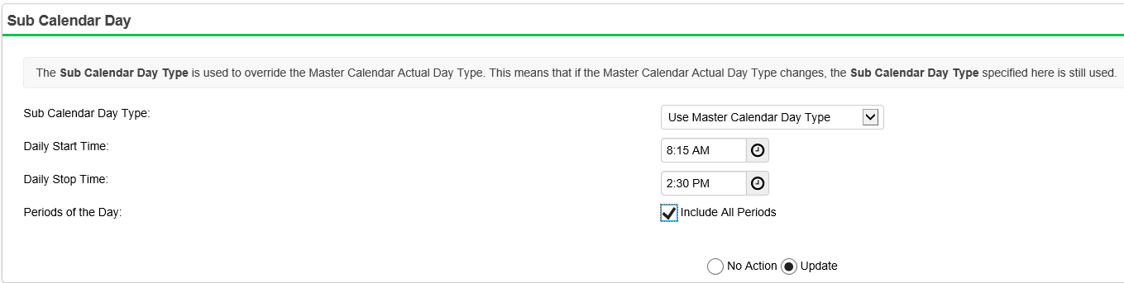
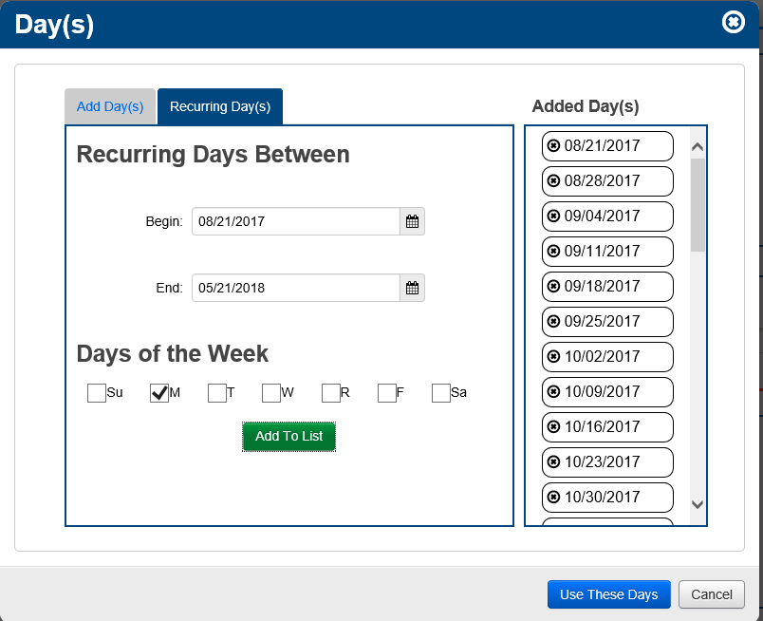
Updating Rotation Day times
Use Calendar Bulk Exception Management
Step #1 for each day, update Daily Start and stop time for all periods
Step #2 – Select Days to update. Use Recurring Days option to quickly select all Monday dates for the school year to update times
Step #3, select the building calendars you wish to update and click Save.
Notes:
If the start and end times are different for each day of the week (rotating/block schedules), Use Calendar Bulk Exception Management to mass update to mass update the days of the week to have different start and end times.
This will need to be done for each day of the weekly rotation, we will use Monday for this example. first update the Sub Calendar Day section and indicate the Daily Start Time and Daily Stop Time that you are going to assign to all Mondays.
Once you have Sub Calendar Day section updated, select the Days. Click on the Recurring Days tab to select all Monday’s in the date range between the first and last day of school. This is easier than selecting each Monday by clicking on every Monday in the calendar for the entire school year.
Step 3, select the calendar(s) you wish to update the start and end times on and click ‘Save’

Slide 31
HB410 Attendance
Some students are considered 100% because of the 5 credit rule. Do you see that being a problem for hours of attendance?
Since we aren’t yet tying attendance to the class, currently, these students are considered present all day regardless of the number of classes they are taking. Their FTE is 100%. If they are absent all day, their absence would be for the full hours of a school day.

Slide 32
HB410 Attendance
If a student is marked absent with a level of AM or PM, but they also enter time in and time out that reduces the number of hours out, will the reports count the absence as a half day or only for the time between in and out time?
If the time in and out are on the absence record, they will be used to more accurately calculate the amount of time absent. With no times included, the absence will be counted as half of the normal school day hours

Slide 33
HB410 Attendance
I’m not understanding the reason for a Partial Absence type. What is the difference?
The partial absence type allows you to add an absence event for a time different than a full or half day that may span from sometime in AM to some time in PM. Regular half-day absences are typically AM only or PM only. This gives greater flexibility to define those chunks of the day a student was out.
Notes:
Half day absences typically are confined to the AM or PM. They don’t span lunch time.
Partials give you the flexibility to add an absence event for a chunk of time during the day that may span from AM to PM or over lunch time. And if Lunches are defined, the lunch time will be subtracted from the total minutes of the Partial Absence.
A student could have multiple partial absences during a single school day too.

Slide 34
HB410 Attendance
Can the Late/Tardy qualifier be used the same as a partial?
Not really. A Late/Tardy typically only has a time in so the student is assumed absent from the start of the day until the time in on the Late/Tardy.
Partials contain time in and out, which gives the exact time the student was out.
Notes:
I wouldn’t recommend crossing Late/Tardy with Partial Absences. It will be easier for the users to understand that a Late/Tardy requires a time in and a Partial requires a time out and in to define the span of time a student was absent.

Slide 35
HB410 Attendance
When you talk about AM and PM absences, do schools now have to have an Absence Cut-off time entered on the StudentInformation Options attendance tab?
The Absence Cut-off Time is used by period attendance to determine the cutoff time to make a half day absence AM or PM. It doesn’t affect anything for our calculations for HB410 or EMIS.
Notes:
The absence cut-off time determines whether an absence is considered a half day AM or PM only absences depending on the times defined on the periods of the day. But if you don’t have the times on all periods AND you’re not taking period attendance, this setting doesn’t really do anything.

Slide 36
HB410 Attendance
If a student is out in the AM but returns at 10:30, why can’t you just mark ½ day absent but put the time in of 10:30 instead of adding a partial absence?
You could do it this way. Either way is fine. As long as the student’s time out doesn’t span lunch, either way is acceptable.
Notes:
Either way will work in the calculation. It comes down to what is easiest for the district to understand and consistently add absence records. The only difference would be is if they don’t’ enter that ‘in’ time, the absence would count as a full half-day absences (total hours for the day/2) so they must make sure to enter that time in.

Slide 37
HB410 Attendance
On senior privilege option where they come in later one period, if they put them on a sub-calendar and have the start time different than the master, would that be sufficient or would they have to enter exceptions for each day too?
If this is a consistent time that can be defined on the calendar, it would be better if they were on a separate calendar and the Start and Stop times for the day be adjusted on the calendar days.
Notes:
The more detail you can add to days for students on a calendar, the more accurately we will be able to calculate the hours for each absence for the student. Since their attendance pattern differs slightly than for other grade levels, it is probably best that they be on a separate calendar.

Slide 38
HB410 Attendance
Are period attendance schools still supposed to be entering a time in/out on the daily absence record that is system generated after taking period attendance?
Yes, they do need to update the Daily Attendance records with the times if the absence doesn’t span the whole or half day. Period attendance only creates records when the number of periods absent hits a predefined threshold. So, absences such as partials and Tardies don’t get a daily event generated and must be created on daily absence.

Slide 39
HB410 Attendance
Are there plans to utilize the start/end times on ALL periods of the day to calculate hours missed – not just deducting the lunch period times?
We do have plans to look at the period attendance records in the future, however, modifications will be needed. ODE has indicated that there will be changes in how attendance is reported next year so we are waiting on those requirements to get an understanding of all changes we will need to make to the attendance process.

Slide 40
Thank you
Thank You!!

